Slide 1
PANORAMA 1: Further Characterization of Safety and Efficacy Update on ASH 2014 Presentations
Abstract #4742
San-Miguel JF

Slide 2
PANORAMA 1: Outcome of Myeloma Patients
Changes in OS from 1970-2006¹
Refractory to BTZ & IMiD²
100
1971-1976
1977-1982
1983-1988
1989-1994
1995-2000
2001-2006
Median (range), Mos
100
Events/N
80
Overall survival
170/286
9
(7-11)
80
Event-free survival
217/286
5
(4-6)
60
60
Overall Survival, %
Patients, %
40
40
20
20
0
0
0
20
40
60
80
100
120
140
0
12
24
36
48
60
Time From Diagnosis, months
Duration From Time Zero, months
Despite the benefit observed with novel agents in the last years, … other drugs are still needed for relapsed/refractory patients
1. Kumar SK, et al. Blood. 2008;111:2516-2520 2. Kumar SK, et al. Leukemia. 2012;26:149-157.
San-Miguel JF, et al. Blood. 2014;124: Abstract 4742.

Slide 3

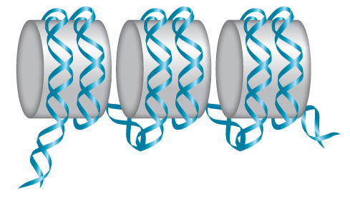
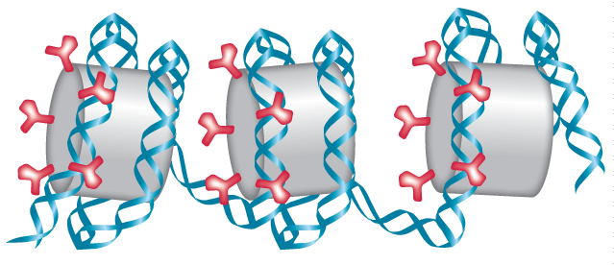



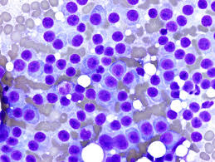
Histone Deacetylases (DACs): Role in Cancer
Histone
Acetyl-Histone
DACs are a family of enzymes that regulate target protein activity through removal of acetyl groups¹
Dysregulated DAC activity is an epigenetic hallmark of cancer (including MM) resulting in aberrant gene expression and cellular signaling that promotes cell cycle progression, cell growth and survival, and resistance to apoptosis³⁻⁵
Panobinostat (PAN) is a potent, oral pan-DACi that increases acetylation of proteins involved in multiple oncogenic pathways
HAT
HDAC
HAT
1. Bolden JE, et al. Nat Rev Drug Discov. 2006;5:769-784. 2. Choudhary C, et al. Science. 2009;324:834-840. 3. West AC, et al. J Clin Invest. 2014;124:30-39. 4. Gryder BE, et al. Future Med Chem. 2012;4:505-524. 5. Stimson L, et al. Ann Oncol. 2009;20:1293-1302.
HDAC
MM Tumor Cells
San-Miguel JF, et al. Blood. 2014;124: Abstract 4742.

Slide 4


PANORAMA 1: Preclinical Activity of PAN-BTZ-Dex in MM
Activity in vitro
120
Changes in GEP
1.0
100
0.8
Apoptosis 15-25%
0.6
2000
80
Effect
MTT uptake (% control)
0.4
60
0.2
1500
1206
0
Deregulated genes
40
0
1
2
3
4
1000
Dose
500
466
20
Panob+Bort
Bort + Dex
156
219
0
Panob + Dex
Panob + Bort + Dex
0
-
-
-
-
Panob
Bort
Dex
PBD
+
+
+
+
Panob
CI in the highly synergistic range (0.1-0.2)
895 genes exclusive of PBD
Bort
Dex
Bort+Dex
Activity in vivo
3600
1.0
Trabecular bone
3000
C
B
*
0.8
Vehicle
Panobinostat
2400
P
PB
*
Tumor volume (mm³)
D
BD
PBD
**
0.6
PB
1800
Survival
1200
*
0.4
PD
*
**
600
0.2
BD
PD
PBD
0
0.0
C
B
D
P
0
10
20
30
40
50
60
70
80
0
20
40
60
80
100
120
Days of treatment
Days of treatment
Mitsiades CS, et al. Cancer Res. 2008;68(13):5216-5225. Ocio EM, et al. Haematologica. 2010;95(5):794-803.
San-Miguel JF, et al. Blood. 2014;124: Abstract 4742.

Slide 5
PANORAMA 1: Panobinostat + Bortezomib + (Dex) in Relapsed MM: Phase I and II Experience
Phase Ib^{1*}
62 patients ………………… 61% ≥MR (51% PR)
BTZ refractory ………… 42% ≥MR (26% PR)
AE (Grade 3): thrombocytopenia 66%, neutropenia 43, fatigue 15% , PN 2% (expansion)
Phase II (PANORAMA 2)^{2†} (BTZ-Ref and ≥1 IMiD: Len 98%)
55 patients……………… 52% ≥ MR (34% PR) PFS: 5.4 months
PAN-BTZ-Dex can recapture responses in BTZ-refractory MM
1. San Miguel JF, et al. J Clin Oncol. 2013;31:3696-3703.
2. Richardson PG, et al. Blood. 2013;122:2331-2337.
*Three wk cycles × 8 (MTD: 20 mg PAN; 1.3 mg/m² BTZ) (2 wks on /1 wk off) (47 in escalation and 15 in expansion phase)
†Eight 3 w cycles PAN (20 mg) + BTZ (1.3 mg/m² )+ Dex (20 mg)
San-Miguel JF, et al. Blood. 2014;124: Abstract 4742.

Slide 6
PANORAMA 1: Study Design Randomized, Double-Blind, Phase III Study in Relapsed or Relapsed and Refractory MM
Treatment Phase I
Treatment Phase II
Patients (N = 768)
Rel or Rel/Ref MM (BTZ-ref excluded)
1-3 prior lines of therapy
Stratification factors
Prior lines of therapy
Prior BTZ
Follow-up
Eight 21-Day cycles (24 wks)
Four 42-Day cycles (24 wks)
Panobinostat + bortezomib + dexamethasone
Panobinostat + bortezomib + dexamethasone
Placebo + bortezomib + dexamethasone
Placebo + bortezomib + dexamethasone
Patients with clinical benefitª in treatment phase I, can proceed to treatment phase II
Primary endpoint: PFS (per modified EBMT criteria; confirmed by IRC)^{1,2}
Key secondary endpoint: OS
Other secondary endpoints: ORR, nCR/CR rate, DOR, TTR, TTP, QoL, and safety
Study conducted at 215 centers across 34 countries
ªAchieving ≥no change according to modified EBMT criteria (SD or better)
1. Blade J, et al. Br J Haematol. 1998;102:1115-1123. 2. Richardson PG, et al. N Engl J Med. 2003; 348:2609-2617.
San-Miguel JF, et al. Blood. 2014;124: Abstract 4742.
Notes:
Follow-up: 28 days post-treatment/discontinuation and every 3 months thereafter

Slide 7
PANORAMA 1: Endpoint Met (PFS)
 | Events | Median PFS (95% CI) months | HR (95% CI) | P value
PAN-BTZ-Dex | 207/387 | 12.0 (10.3, 12.9) | 0.63 (0.52-0.76) | <.0001
Pbo-BTZ-Dex | 260/381 | 8.1 (7.6, 9.2)
100
80
60
40
20
0
Progression-free survival Probability (%)
PAN-BTZ-Dex
Pbo-BTZ-Dex
0 | 2 | 4 | 6 | 8 | 10 | 12 | 14 | 16 | 18 | 20 | 22 | 24 | 26 | 28 | 30 | 32 | 34 | 36
Number of patients at risk
Months
PAN-BTZ-Dex
Pbo-BTZ-Dex
387 | 288 | 241 | 202 | 171 | 143 | 113 | 89 | 69 | 52 | 44 | 35 | 26 | 18 | 13 | 10 | 5 | 3 | 0
381 | 296 | 235 | 185 | 143 | 114 | 89 | 64 | 42 | 32 | 24 | 18 | 12 | 5 | 5 | 3 | 2 | 0 | 0
Primary endpoint was met (P<.0001), with clinically relevant increase in median PFS of 3.9 months for PAN-BTZ-Dex arm
San-Miguel JF, et al. Blood. 2014;124: Abstract 4742.

Slide 8
PANORAMA 1: Subgroup Analysis of PFS Benefit Maintained Regardless of Baseline Characteristics
Hazard ratio (95% CI)
Overall (n = 768)
Race
- Caucasian (n = 499)
- Asian (n = 232)
- Other (n = 37)
Sex
- Male (n = 407)
- Female (n = 361)
Age
- < 65 (n = 445)
- ≥ 65 (n = 323)
Clinical staging by ISS
- Stage I (n = 308)
- Stage II and III (n = 359)
Cytogenetic risk group
- Normal risk (n = 167)
- Poor risk (n = 37)
0.63 (0.52-0.76)
0.69 (0.55-0.86)
0.54 (0.38-0.78)
0.77 (0.27-2.19)
0.54 (0.41-0.70)
0.76 (0.57-1.00)
0.59 (0.46-0.76)
0.72 (0.53-0.96)
0.62 (0.46-0.85)
0.61 (0.47-0.80)
0.88 (0.60-1.29)
0.47 (0.18-1.25)
0.25
0.5
0.75
1
1.25
1.5
1.75
2
2.25
PAN-BTZ-Dex
Pbo-BTZ-Dex
San-Miguel JF, et al. Blood. 2014;124: Abstract 4742.

Slide 9
PANORAMA 1: Subgroup Analysis of PFS Benefit Maintained Regardless of Prior Treatment History
Hazard ratio (95% CI)
Overall (n = 768)
Number of prior lines of MM therapy
- 1 line (n = 352)
- 2 or 3 lines (n = 416)
Prior use of BTZ
- No (n = 432)
- Yes (n = 336)
Prior stem cell transplantation
- No (n = 329)
-Yes (n = 439)
Prior use of IMiDs
- No (n = 283)
- Yes (n = 485)
Prior use of IMiDs and BTZ
- No (n = 570)
- Yes (n = 198)
MM characteristics
- Relapsed and refractory (n = 275)
- Relapsed (n = 482)
0.63 (0.52-0.76)
0.66 (0.50-0.86)
0.64 (0.50-0.83)
0.68 (0.53-0.87)
0.58 (0.44-0.77)
0.64 (0.48-0.85)
0.64 (0.50-0.81)
0.78 (0.57-1.08)
0.54 (0.43-0.68)
0.68 (0.55-0.85)
0.53 (0.37-0.76)
0.54 (0.39-0.75)
0.70 (0.56-0.89)
0.25
0.5
0.75
1
1.25
1.5
1.75
2
2.25
PAN-BTZ-Dex
Pbo-BTZ-Dex
San-Miguel JF, et al. Blood. 2014;124: Abstract 4742.

Slide 10
Overall Survival at Time of Final PFS Analysis
Study D2308
HR (95% CI) = 0.87 (0.69, 1.10)
Log-rank P = .259
Kaplan-Meier medians
PAN+BTZ+Dex: 33.64 months
PBO+BTZ+Dex: 30.39 months
Patients at risk
PAN+BTZ+Dex | 387 | 362 | 333 | 315 | 306 | 295 | 284 | 276 | 265 | 241 | 210 | 178 | 147 | 118 | 92 | 64 | 40 | 25 | 12 | 7 | 4 | 0
PBO+BTZ+Dex | 381 | 365 | 344 | 326 | 314 | 297 | 284 | 273 | 251 | 234 | 211 | 164 | 140 | 115 | 90 | 59 | 39 | 24 | 15 | 9 | 4 | 0
San-Miguel JF, et al. Blood. 2014;124: Abstract 4742.

Slide 11
OS: Second Interim Analysis (86% of Events) PANORAMA 1: Longer Median OS With PAN+BTZ+Dex
HR (95% CI) = 0.87 (0.70, 1.07)
Log-rank P =.1783
Kaplan-Meier medians
PAN+BTZ+Dex: 38.24 months
PBO+BTZ+Dex: 35.38 months
Cut-off date: August 2014
Patients at risk
PAN+BTZ+Dex | 387 | 363 | 308 | 286 | 267 | 244 | 228 | 206 | 163 | 101 | 59 | 26 | 10 | 2 | 0
PBO+BTZ+Dex | 381 | 345 | 315 | 284 | 251 | 238 | 213 | 187 | 150 | 101 | 60 | 24 | 8 | 3 | 0
San-Miguel JF, et al. Blood. 2014;124: Abstract 4742.

Slide 12
PANORAMA 1: Dose Intensity
 | PAN-BTZ-Dex n = 387 |  |  | Pbo-BTZ-Dex n = 381
 | PAN | BTZ | Dex | Pbo | BTZ | Dex
Relative dose intensity, %
Median (range) | 80.7 (41-104) | 75.7 (31-106) | 87.5 (35-106) | 95.1 (45-250) | 86.7 (31-105) | 95.1 (27-106)
Relative dose intensity of PAN decreased to 78.2% at cycle 3 and remained stable through the remainder of the trial
Dose reduction of PAN 20 mg → 15 mg → 10 mg per protocol
Median duration of treatment
PAN-BTZ-Dex: 152 days (3-411)
Pbo-BTZ-Dex: 187 days (3-443)
San-Miguel JF, et al. Blood. 2014;124: Abstract 4742.
Notes:
AEs leading to dose adjustment or temporary dose interruption: PAN/BTZ/DEX: 88.7%; Pbo/BTZ/Dex: 75.6%

Slide 13
Introduction: TP1/TP2 Analysis
Panobinostat is a pan-deacetylase inhibitor that inhibits a broad range of deacetylase enzymes, which target key aberrations in MM cell biology, including protein metabolism and epigenetics¹
In the phase 3 PANORAMA 1 trial, PAN-BTZ-Dex demonstrated an ~ 4 month PFS benefit compared with Pbo-BTZ-Dex²
A higher rate of grade 3/4 adverse events (AEs) and laboratory abnormalities were observed in patients receiving PAN vs Pbo: thrombocytopenia (67% vs 31%); lymphopenia (53% vs 40%); diarrhea (26% vs 8%); asthenia/fatigue (24% vs 12%); and peripheral neuropathy (18% vs 15%)
1. Atadja P. Cancer Lett. 2009;280:233-224. 2. San-Miguel JF, et al. Lancet Oncol. 2014;15:1195-1206.
San-Miguel JF, et al. Blood. 2014;124: Abstract 4742.

Slide 14
TP1/TP2 Analysis

Slide 15
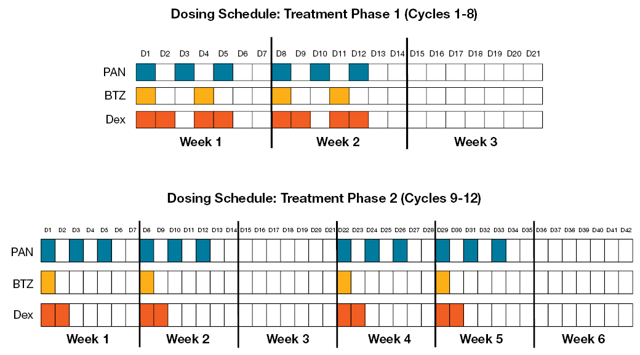
PANORAMA 1: Treatment Schedule
Treatment Phase I (TP1) (cycles 1-8)
Treatment Phase II (TP2) (cycles 9-12)
PAN: Panobinostat 20 mg orally
BTZ: Bortezomib 1.3 mg/m² intravenously
Dex: Dexamethasone 20 mg orally
Patients who demonstrated clinical benefit (≥ SD) in TP1 could proceed to TP2 in which BTZ was administered less frequently on a once-weekly schedule
San-Miguel JF, et al. Blood. 2014;124: Abstract 4742.
Notes:
PANORAMA 1 was composed of two treatment phases: TP1 and TP2 (Figure 1)
Patients who demonstrated clinical benefit (≥ SD) in TP1 could proceed to TP2 in which BTZ was administered less frequently on a once-weekly schedule
Dex was administered on the days of and after BTZ

Slide 16
Rationale and Methods
Recent data have demonstrated that once-weekly BTZ is associated with improved tolerability in patients with MM¹
Therefore a detailed analysis of the safety and efficacy profile of patients treated in TP2, where BTZ was administered once weekly, are of interest to further understand and characterize this combination
Efficacy and safety outcomes were analyzed by treatment phase
TP1: Includes patients who completed 8 cycles of treatment and received at least 1 dose in cycle 9
TP2: Includes patients who completed 12 cycles of treatment per protocol
1.Bringhen S, et al. Blood. 2010;116:4745-4753.
San-Miguel JF, et al. Blood. 2014;124: Abstract 4742.

Slide 17
Reasons for Treatment Discontinuation
 | All patients |  | During TP1 (cycles 1-8)
Primary reason for end of treatment, n (%) | PAN+BTZ+Dex n = 387 | Pbo+BTZ+Dex n = 381 | PAN+BTZ+Dex n = 387 | Pbo+BTZ+Dex n = 381
Adverse event(s) | 130 (33.6) | 66 (17.3) | 112 (28.9) | 63 (16.5)
Disease progression | 82 (21.2) | 153 (40.2) | 41 (10.6) | 78 (20.5)
Withdrew consent | 34 (8.8) | 18 (4.7) | 31 (8.0) | 17 (4.5)
Death | 21 (5.4) | 17 (4.5) | 20 (5.2) | 16 (4.2)
Other | 18 (4.7) | 25 (6.6) | 14 (3.6) | 15 (3.9)
Treatment duration completed | 102 (26.4) | 102 (26.8) | 169 (43.7) | 192 (50.4)
In the PAN-BTZ-Dex arm (n = 387), the most common reasons for discontinuation in TP1 were: AEs (28.9%), disease progression (10.6%), withdrawal of consent (8.0%), and death (5.2%)
San-Miguel JF, et al. Blood. 2014;124: Abstract 4742.
Notes:
In the Pbo-BTZ-Dex arm (n = 381), the most common reasons for discontinuation in TP1 were: disease progression (20.5%), AEs (16.5%), withdrawal of consent (4.5%), and death (4.2%)

Slide 18
Summary of Efficacy by Treatment Phase
 | PAN+BTZ+Dex | Pbo+BTZ+Dex
All patients | N = 387 | N = 381
ORR, % (95% CI) | 60.7 (55.7, 65.6) | 54.6 (49.4, 59.7)
nCR/CR, % (95% CI) | 27.6 (23.2, 32.4) | 15.7 (12.2, 19.8)
Median PFS, mo (CI) | 11.99 (10.32, 12.94) | 8.08 (7.56, 9.23)ª
Completed TP1 (n) | n = 169 | n = 192
ORR, % (95% CI) | 85.2 (78.9, 90.2) | 80.2 (73.9, 85.6)
nCR/CR, % (95% CI) | 46.2 (38.5, 54.0) | 25.0 (19.0, 31.7)
Median PFS, mo (CI) | 14.65 (12.94,16.85) | 12.09 (10.61, 13.14)
Completed TP2 (n) | n = 102 | n = 102
ORR, % (95% CI) | 88.2 (80.4, 93.8) | 91.2 (83.9, 95.9)
nCR/CR, % (95% CI) | 52.9 (42.8, 62.9) | 38.2 (28.8, 48.4)
Median PFS, mo (CI) | 17.64 (15.9, 20.07) | 15.64 (14.39, 18.00)
ªP<.0001
As expected, a longer duration of treatment was associated with an increased rate of higher quality responses (nCR/CR) and median PFS
San-Miguel JF, et al. Blood. 2014;124: Abstract 4742.

Slide 19
Summary of Efficacy by Treatment Phase for Patients Who Completed TP2
Progression-Free Survival Probability, %
100
80
60
Censoring times
PAN+BTZ+Dex (n/N = 56/102)
PBO+BTZ+Dex (n/N = 69/102)
40
20
Kaplan-Meier medians
PAN+BTZ+Dex: 17.64 months
PBO+BTZ+Dex: 15.64 months
0
0
2
4
6
8
10
12
14
16
18
20
22
24
26
28
30
32
34
36
No. of patients still at risk
Time, months
Time, months
PAN+BTZ+Dex
PBO+BTZ+Dex
0
102
102
2
95
96
4
95
96
6
94
96
8
93
95
10
93
93
12
76
78
14
60
54
16
48
37
18
36
28
20
30
22
22
24
16
24
17
11
26
11
4
28
8
4
30
6
2
32
3
1
34
1
0
36
0
0
San-Miguel JF, et al. Blood. 2014;124: Abstract 4742.

Slide 20
Summary of Adverse Events by Treatment Phase (Occurring in >30% of Patients in Either Arm)
 | TP1 |  |  |  | TP2
 | PAN+BTZ+Dex n = 381 |  | Pbo+BTZ+Dex n = 377 |  | PAN+BTZ+Dex n = 168ª |  | Pbo+BTZ+Dex n = 193ª
Preferred term | All grades, % | Grades 3/4, % | All grade, % | Grades 3/4, % | All grades, % | Grades 3/4, % | All grades, % | Grades 3/4, %
Diarrhea | 65.9 | 24.1 | 38.2 | 8.0 | 29.8 | 7.1 | 20.2 | 0.0
Thombocytopenia | 64.3 | 56.7 | 40.1 | 24.4 | 18.5 | 6.0 | 5.2 | 1.0
Anemia | 39.9 | 15.5 | 31.8 | 15.1 | 13.7 | 3.0 | 9.3 | 3.6
Fatigue | 39.6 | 16.3 | 28.9 | 8.8 | 8.9 | 1.8 | 4.7 | 0.0
Nausea | 35.2 | 5.5 | 19.4 | 0.5 | 5.4 | 0.0 | 4.7 | 0.0
Neuropathy peripheral | 29.4 | 6.0 | 32.9 | 4.8 | 6.5 | 3.0 | 11.9 | 1.6
Constipation | 26.0 | 1.0 | 31.8 | 1.1 | 3.6 | 0.0 | 5.7 | 0.0
ªOne patient randomly assigned to receive panobinostat was given placebo during cycles 1 and 2 because of a misallocation error; the patient was subsequently given panobinostat from cycle 3 until discontinuation of treatment, but was included in the placebo group for the safety analysis.
San-Miguel JF, et al. Blood. 2014;124: Abstract 4742.

Slide 21
Summary of AEs by Treatment Phase Among Patients Who Completed TP2 (Occurring in >30% of Patients in Either Arm)
 | TP1 |  |  |  | TP2ª
 | PAN+BTZ+Dex n = 102 |  | Pbo+BTZ+Dex n = 102 |  | PAN+BTZ+Dex n = 102 |  | Pbo+BTZ+Dex n = 102
Preferred Term | All grades, % | Grades 3/4, % | All grades, % | Grades 3/4, % | All grades, % | Grades 3/4, % | All grades, % | Grades 3/4, %
Diarrhea | 74.5 | 25.5 | 35.3 | 5.9 | 32.4 | 8.8 | 21.6 | 0.0
Thrombocytopenia | 60.8 | 47.1 | 30.4 | 10.8 | 21.6 | 5.9 | 6.9 | 1.0
Fatigue | 44.1 | 14.7 | 27.5 | 3.9 | 9.8 | 2.0 | 5.9 | 0.0
Peripheral edema | 37.3 | 1.0 | 25.5 | 1.0 | 11.8 | 0.0 | 7.8 | 0.0
Neuropathy peripheral | 36.3 | 7.8 | 34.3 | 2.0 | 3.9 | 2.9 | 13.7 | 1.0
Neutropenia | 32.4 | 21.6 | 11.8 | 7.8 | 20.6 | 12.7 | 4.9 | 1.0
Anemia | 32.4 | 7.8 | 22.5 | 6.9 | 10.8 | 0.0 | 5.9 | 1.0
Nausea | 31.4 | 3.9 | 16.7 | 1.0 | 3.9 | 0.0 | 4.9 | 0.0
Constipation | 28.4 | 1.0 | 31.4 | 2.0 | 3.9 | 0.0 | 5.9 | 0.0
ªNewly occurring or worsening adverse events
Among patients in the PAN-BTZ-Dex arm who completed TP2, the incidence of newly occurring or worsening grade 3/4 AEs decreased in TP2
Thrombocytopenia (47.1% vs 5.9%); diarrhea (25.5% vs 8.8%); neutropenia (21.6% vs 12.7%)
San-Miguel JF, et al. Blood. 2014;124: Abstract 4742.

Slide 22
Phase I Experience: Incidence of Diarrhea by Dose Cohort (B2207 Study PAN + Dex)
Dose Expansion
2 wks on/ 1 wk off
PAN dose
(mg/day)
BTZ dose
(mg/m²)
N = 7
N = 7
N = 17
N = 9
N = 7
N = 15
San-Miguel JF, et al. Blood. 2014;124: Abstract 4742.

Slide 23
Clinical Impact of Diarrhea in the PANORAMA 1 Study
 | PAN-BTZ-Dex n = 381 | Pbo-BTZ-Dex n = 377
Any grade, % | 68 | 42
Grade 3/4 AE, % | 26 | 8
Grade 3 AE | 24 | 8
Grade 4 AE | 1 | 0.5
Serious AEs, % | 11 | 2
Dose adjusted/temporarily interrupted, % | 26 | 9
Study drug permanently discontinued, % | 5 | 2
Concomitant medication taken/nondrug therapy given, % | 49 | 26
Hospitalization, % | 10 | 2
Grade 3/4 AE episodes per patient
Median (range), n | 1 (1-9) | 1 (1-4)
1 episode, %ª | 65 | 65
2 episodes, %ª | 21 | 32
≥3 episodes, %ª | 14 | 3
San-Miguel JF, et al. Blood. 2014;124: Abstract 4742.
Notes:
Diarrhea serious AEs regardless of causality
PAN-BTZ-Dex: 11%
Pbo-BTZ-Dex: 2%
Dose adjustments/interruptions for diarrhea
PAN-BTZ-Dex: 26%
Pbo-BTZ-Dex: 9%
Diarrhea AEs leading to discontinuations
PAN-BTZ-Dex: 5%
Pbo-BTZ-Dex: 2%

Slide 24
Antidiarrheal Concomitant Medications
 | PAN-BTZ-Dex N = 381 | Pbo-BTZ/Dex N = 377
Total % | 54 | 32
Loperamide | 44 | 24
Diosmectite | 7 | 3
Diphenoxylate/atropine | 3 | 1
Potassium chloride | 2 | 0
Ciprofloxacin | 2 | 1
For management of diarrhea, loperamide was most frequently administered: PAN-BTZ-Dex arm, 44%; Pbo-BTZ-Dex arm, 24%
San-Miguel JF, et al. Blood. 2014;124: Abstract 4742.

Slide 25
Rate of Diarrhea Before and After the First Dose Reduction for Patients Who Received PAN-BTZ-Dex in Treatment Phase I
Rate of diarrhea decreased after the first dose reduction of panobinostat and bortezomib
San-Miguel JF, et al. Blood. 2014;124: Abstract 4742.

Slide 26
Conclusions: TP1/TP2 Analysis
As expected, patients who received a longer duration of treatment on the PAN-BTZ-Dex arm demonstrated improved outcomes (higher nCR/CR rate and median PFS)
The rate of adverse events decreased in TP2, where bortezomib and dexamethasone were administered less frequently
Together, these data support optimizing the management of AEs for patients who receive PAN-BTZ-Dex through dose adjustments or interruptions and/or supportive therapy
These data also support once-weekly administration of bortezomib when used in combination with panobinostat and dexamethasone
San-Miguel JF, et al. Blood. 2014;124: Abstract 4742.

